Slide 1
Greyatom Test Review Sentiment Prediction presented by - Abhineet

Slide 2
PROBLEM STATEMENT
You have been hired by this marketing company to assess and predict the reviews that they have gathered on their products. Based on the review text provided, you need to predict whether the feedback has a positive or negative sentiment
Lets build Machine leaning model to predict Reviews Sentiment.

Slide 3
Business Insights:
Understanding Target variable Distribution in data
Gender Distribution where campaign has gained or failed respectievely.
Detect outliers in the data and handle them.
Do analysis to detect correleation among the columns and handle it.
Evaluation Metric:
Precision_score(macro)

Slide 4
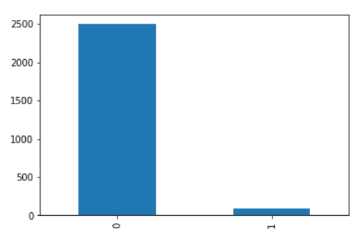
EDA
Dropped id column.
There were no null values.
Netgain column:
- There was imbalance in the data. Value counts observed are as 0:2512, 1:86
- Class imbalance was handled to train the model.

Slide 5
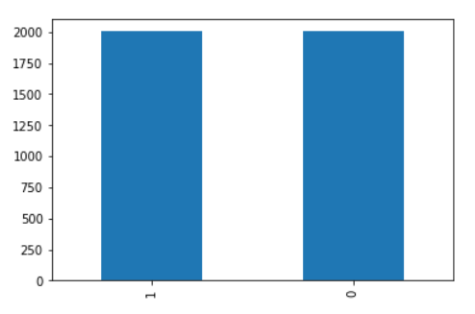
Class imbalance was corrected using RandomOverSampler

Slide 6
Models to train the data
Various Vanilla models were assessed without upsampling the data and tried on the models. The models were:
Logistic Regression
MultinomialNB
RandomForestClassifier
XGBClassifier
GradientBoostingClassifier

Slide 7
Results of the Models:
Model | Precision_score(macro)
logisticRegression | 0.95
RandomForestClassifier | 0.99
MultinomialNB | 0.80
XGBClassifier | 0.89
GradientBoosting | 0.85

